Slide 1
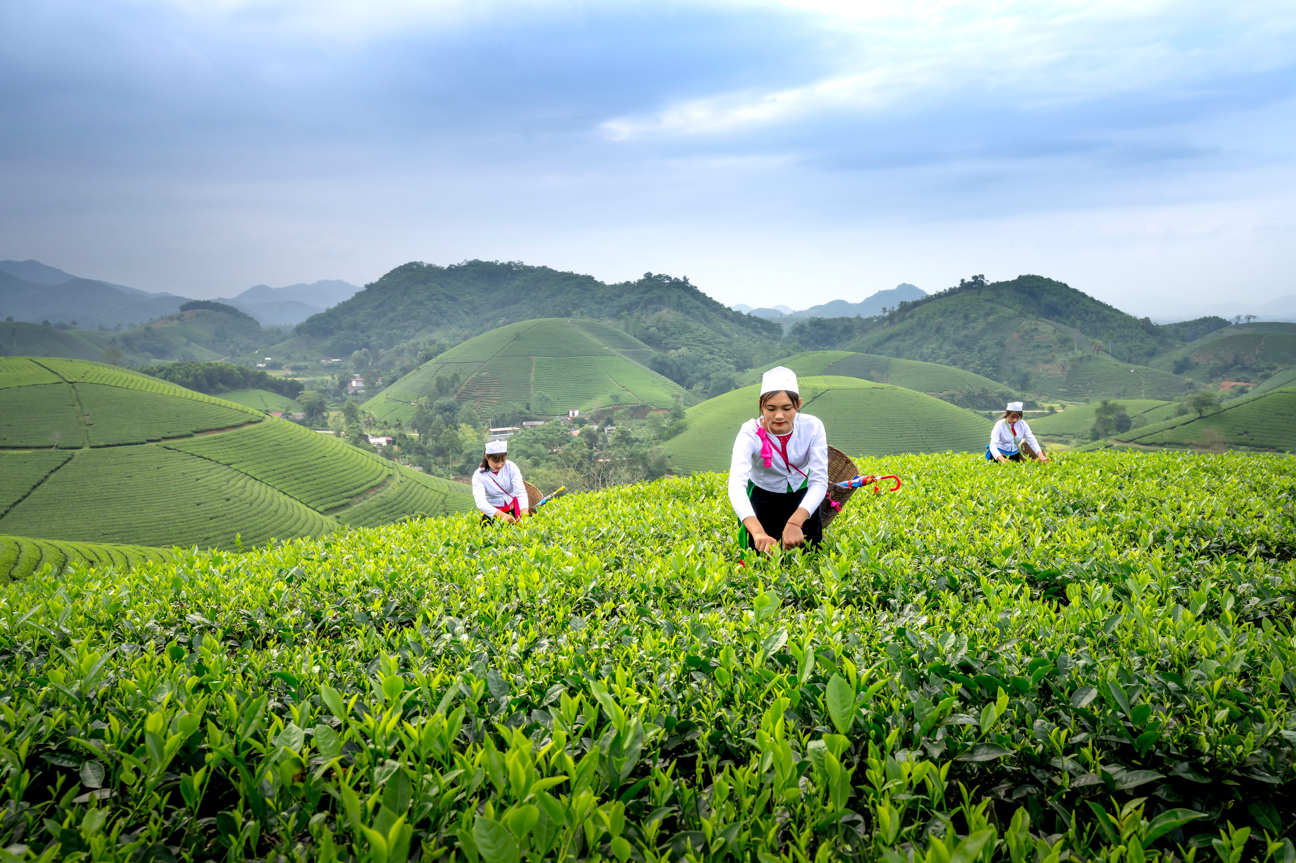
LEARNATHON 4.0 PROJECT
PROJECT PPT BY TEAM 189

Slide 2
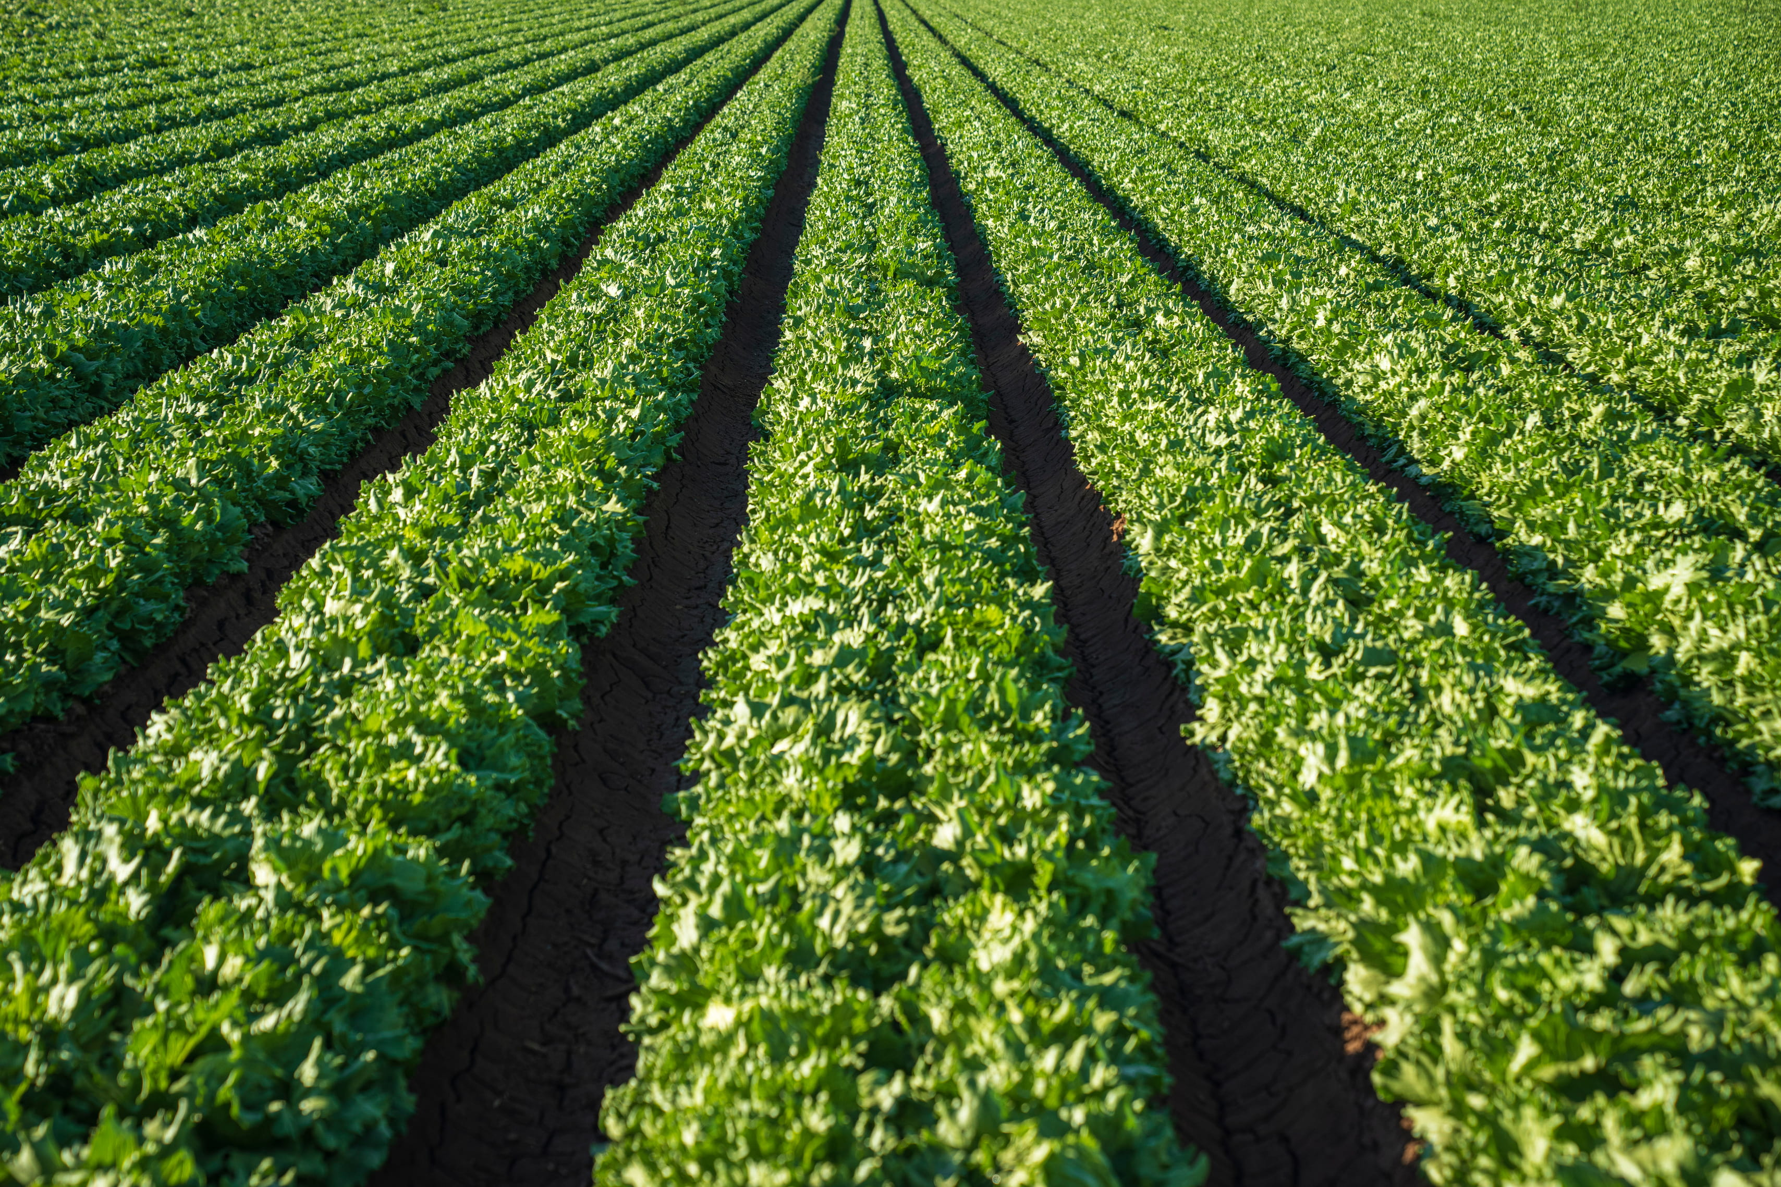


Salford & Co.
Introduction
Development of a Data-Driven Crop Advisory System Using Soil and Environmental Parameters
In the face of climate variability and soil degradation, small and marginal farmers often struggle with selecting the right crop for their land. Traditional farming decisions, often based on experience or guesswork, can lead to poor yields, low profitability, and unsustainable practices.
In this project, we present a data-driven crop advisory system that uses soil macronutrients (N, P, K), pH level, temperature, humidity, and rainfall to intelligently recommend the most suitable crop for cultivation.
Using machine learning techniques, the system analyzes real-time or historical environmental data to provide accurate crop recommendations — ultimately guiding farmers toward smarter, more efficient, and sustainable farming decisions.

Slide 3
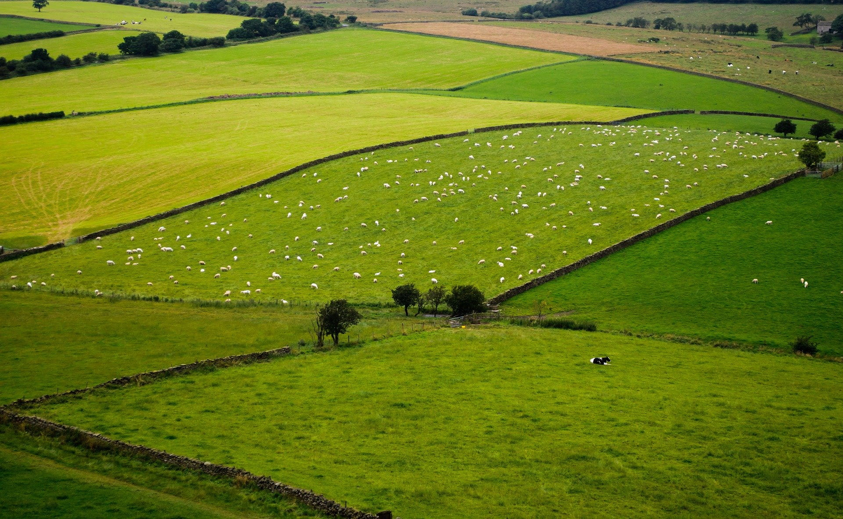

Our Approach to Farmers
Many small farmers rely on traditional practices or local advice to choose crops — often without understanding how soil nutrients, pH, and weather impact crop performance. This can lead to poor yield, high input costs, and soil degradation.
We designed this system to support small and marginal farmers who often lack access to expert guidance. By using simple, accessible inputs like soil nutrients, pH, and local weather data, our model recommends the most suitable crop to cultivate.
The system removes guesswork, helps reduce costs, and boosts productivity — all through an easy-to-use, data-driven tool that empowers farmers to make smarter, more sustainable decisions.

Slide 4
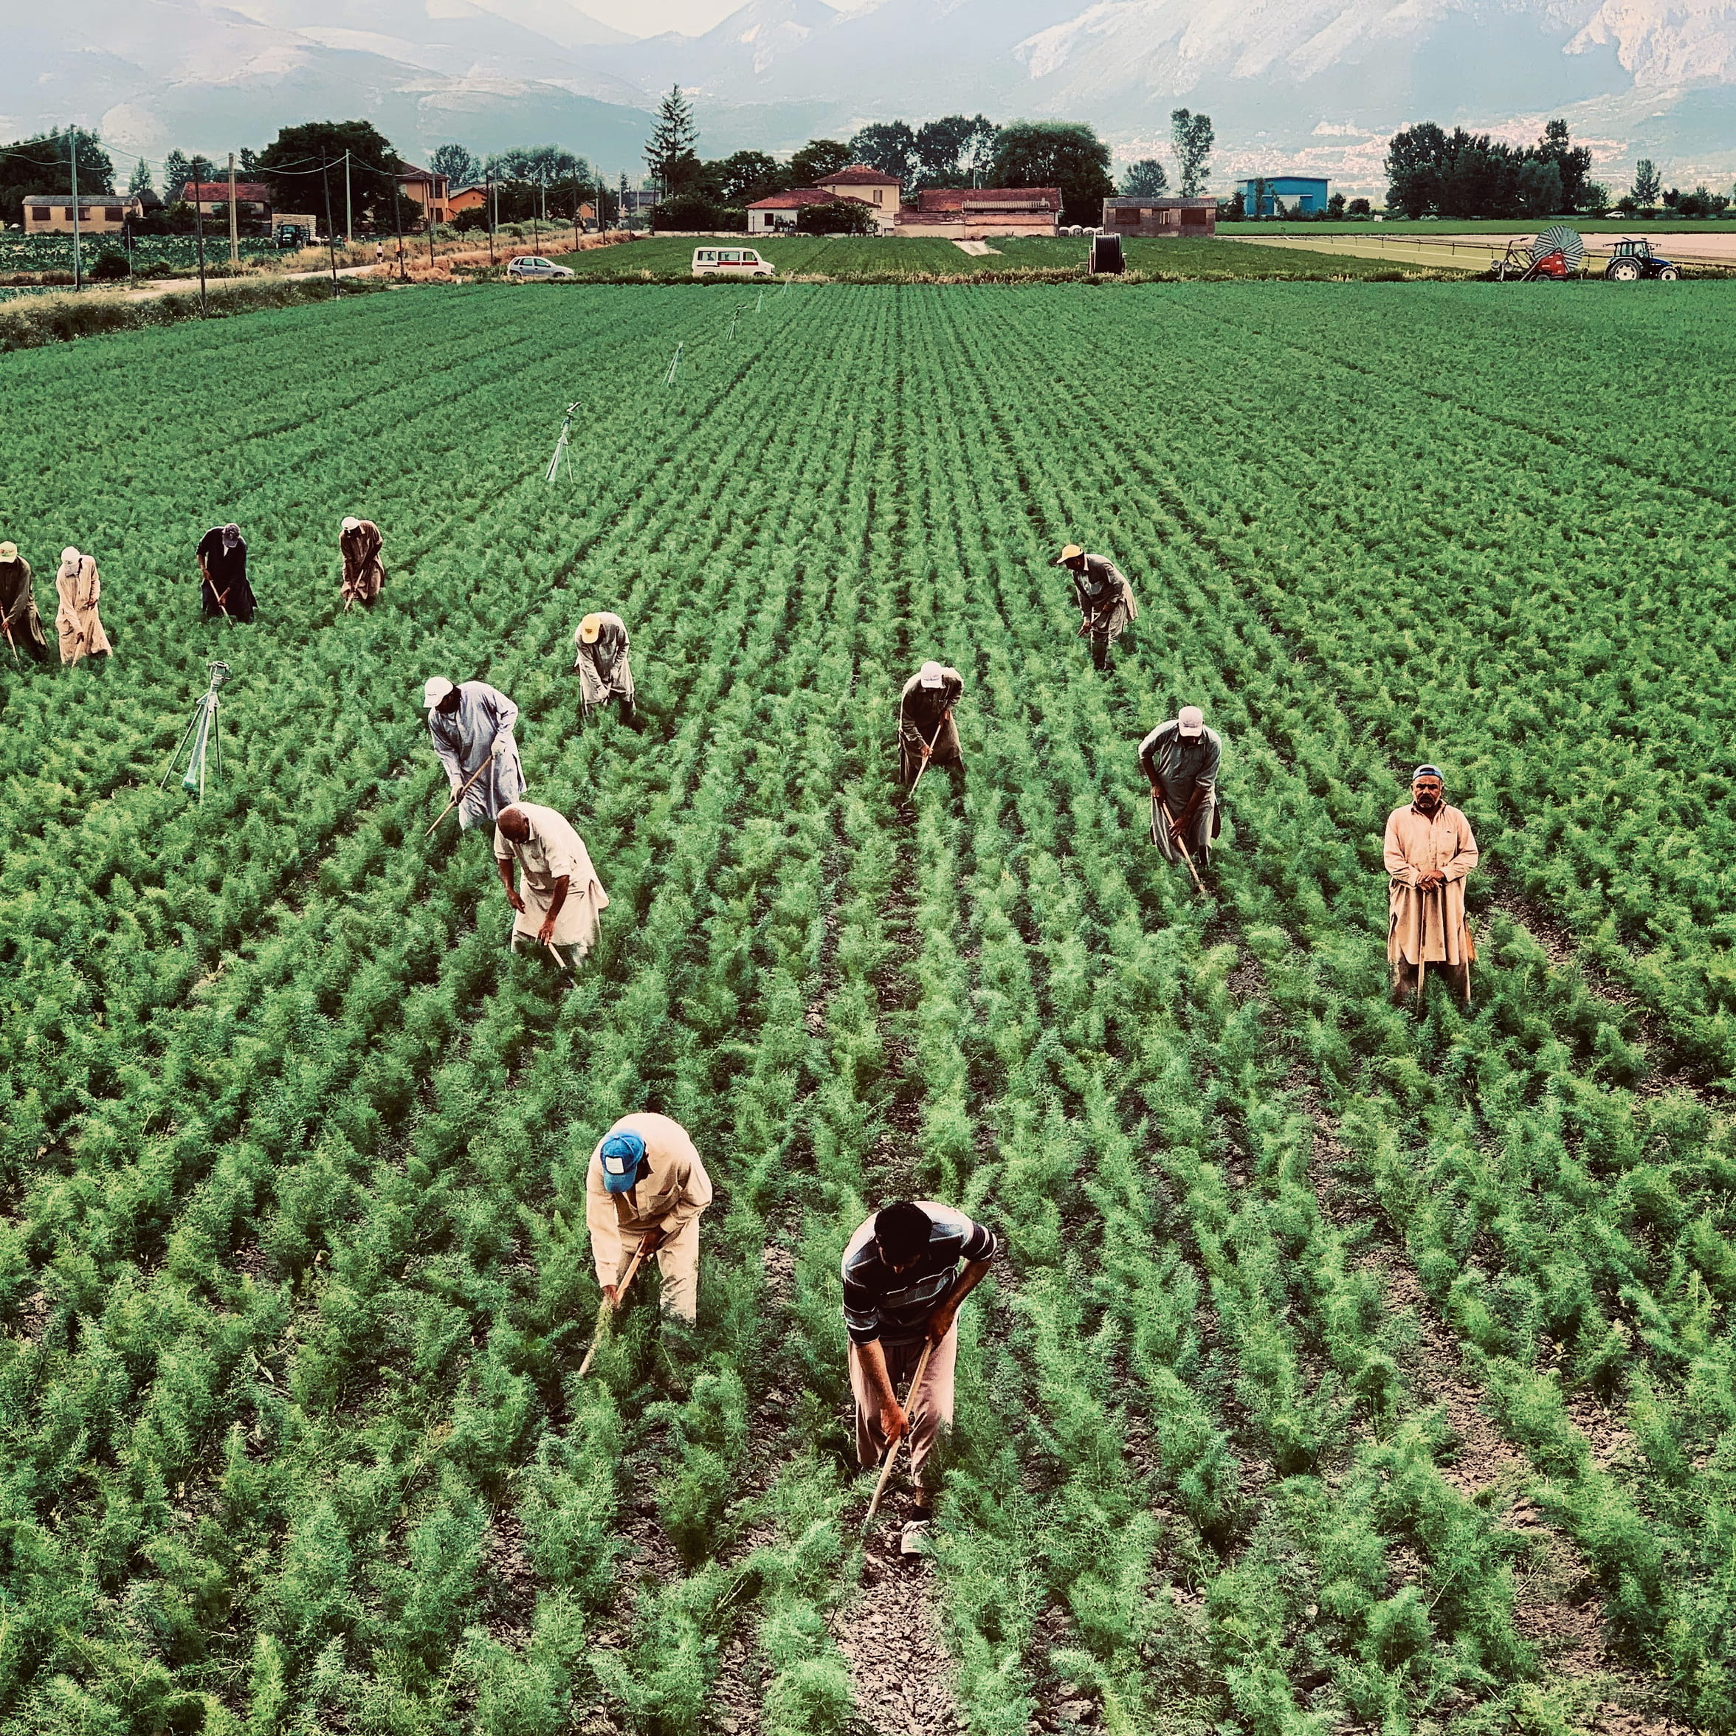
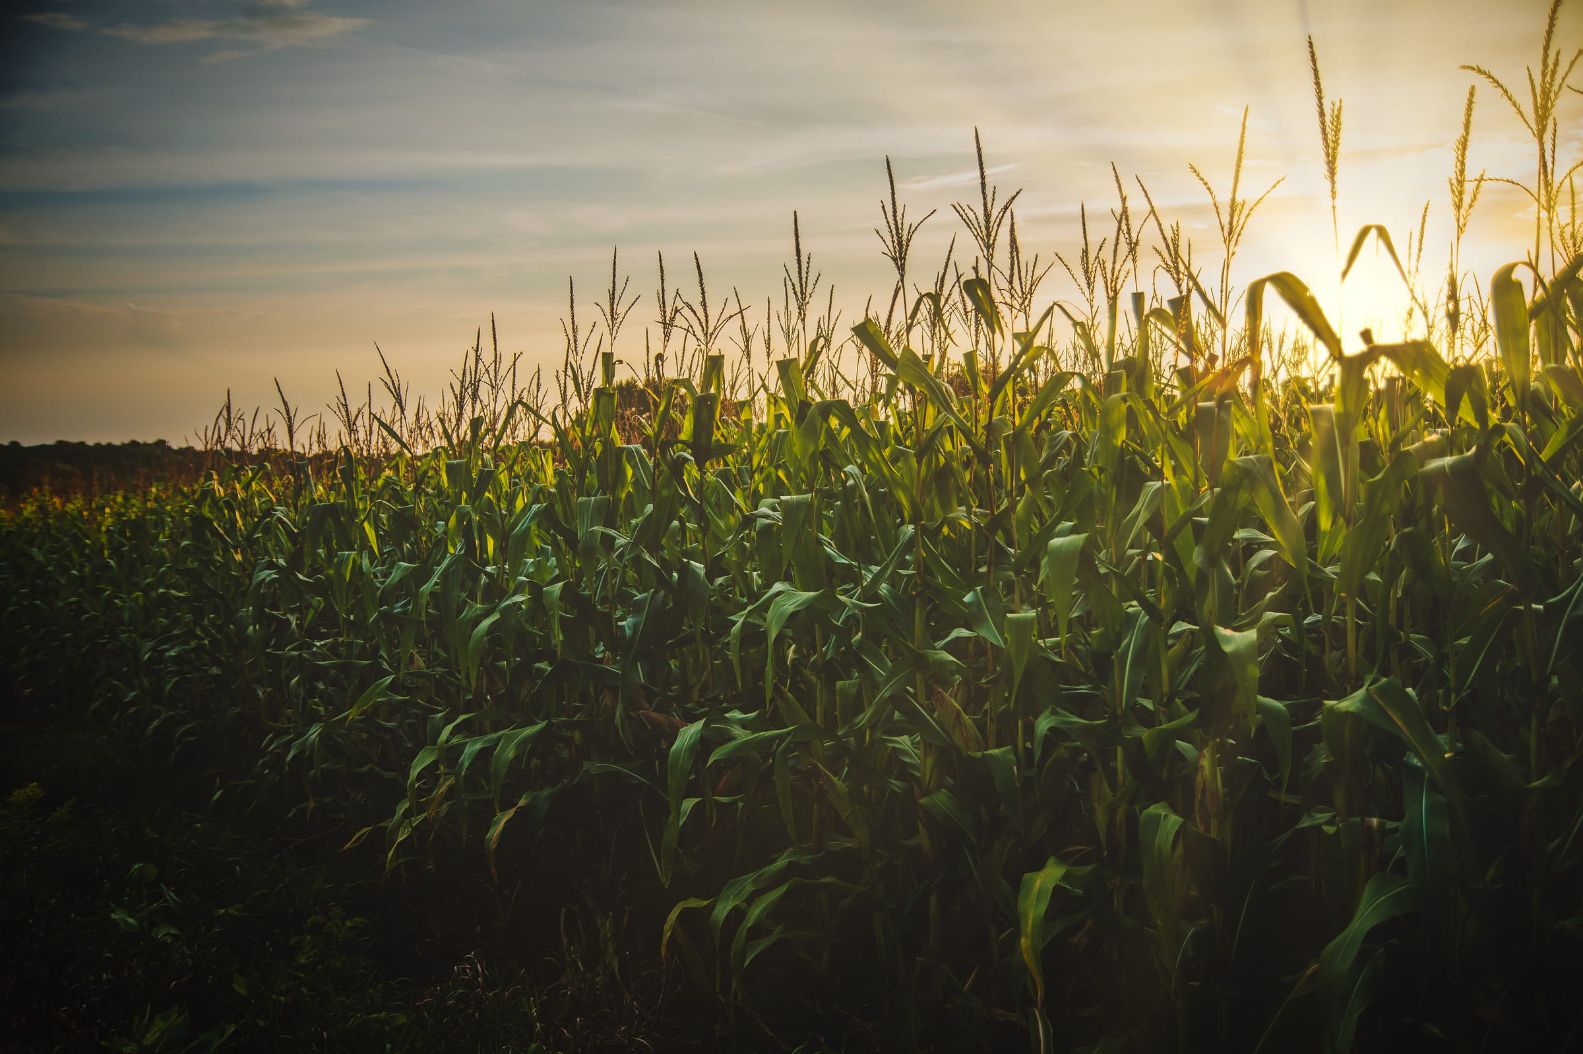
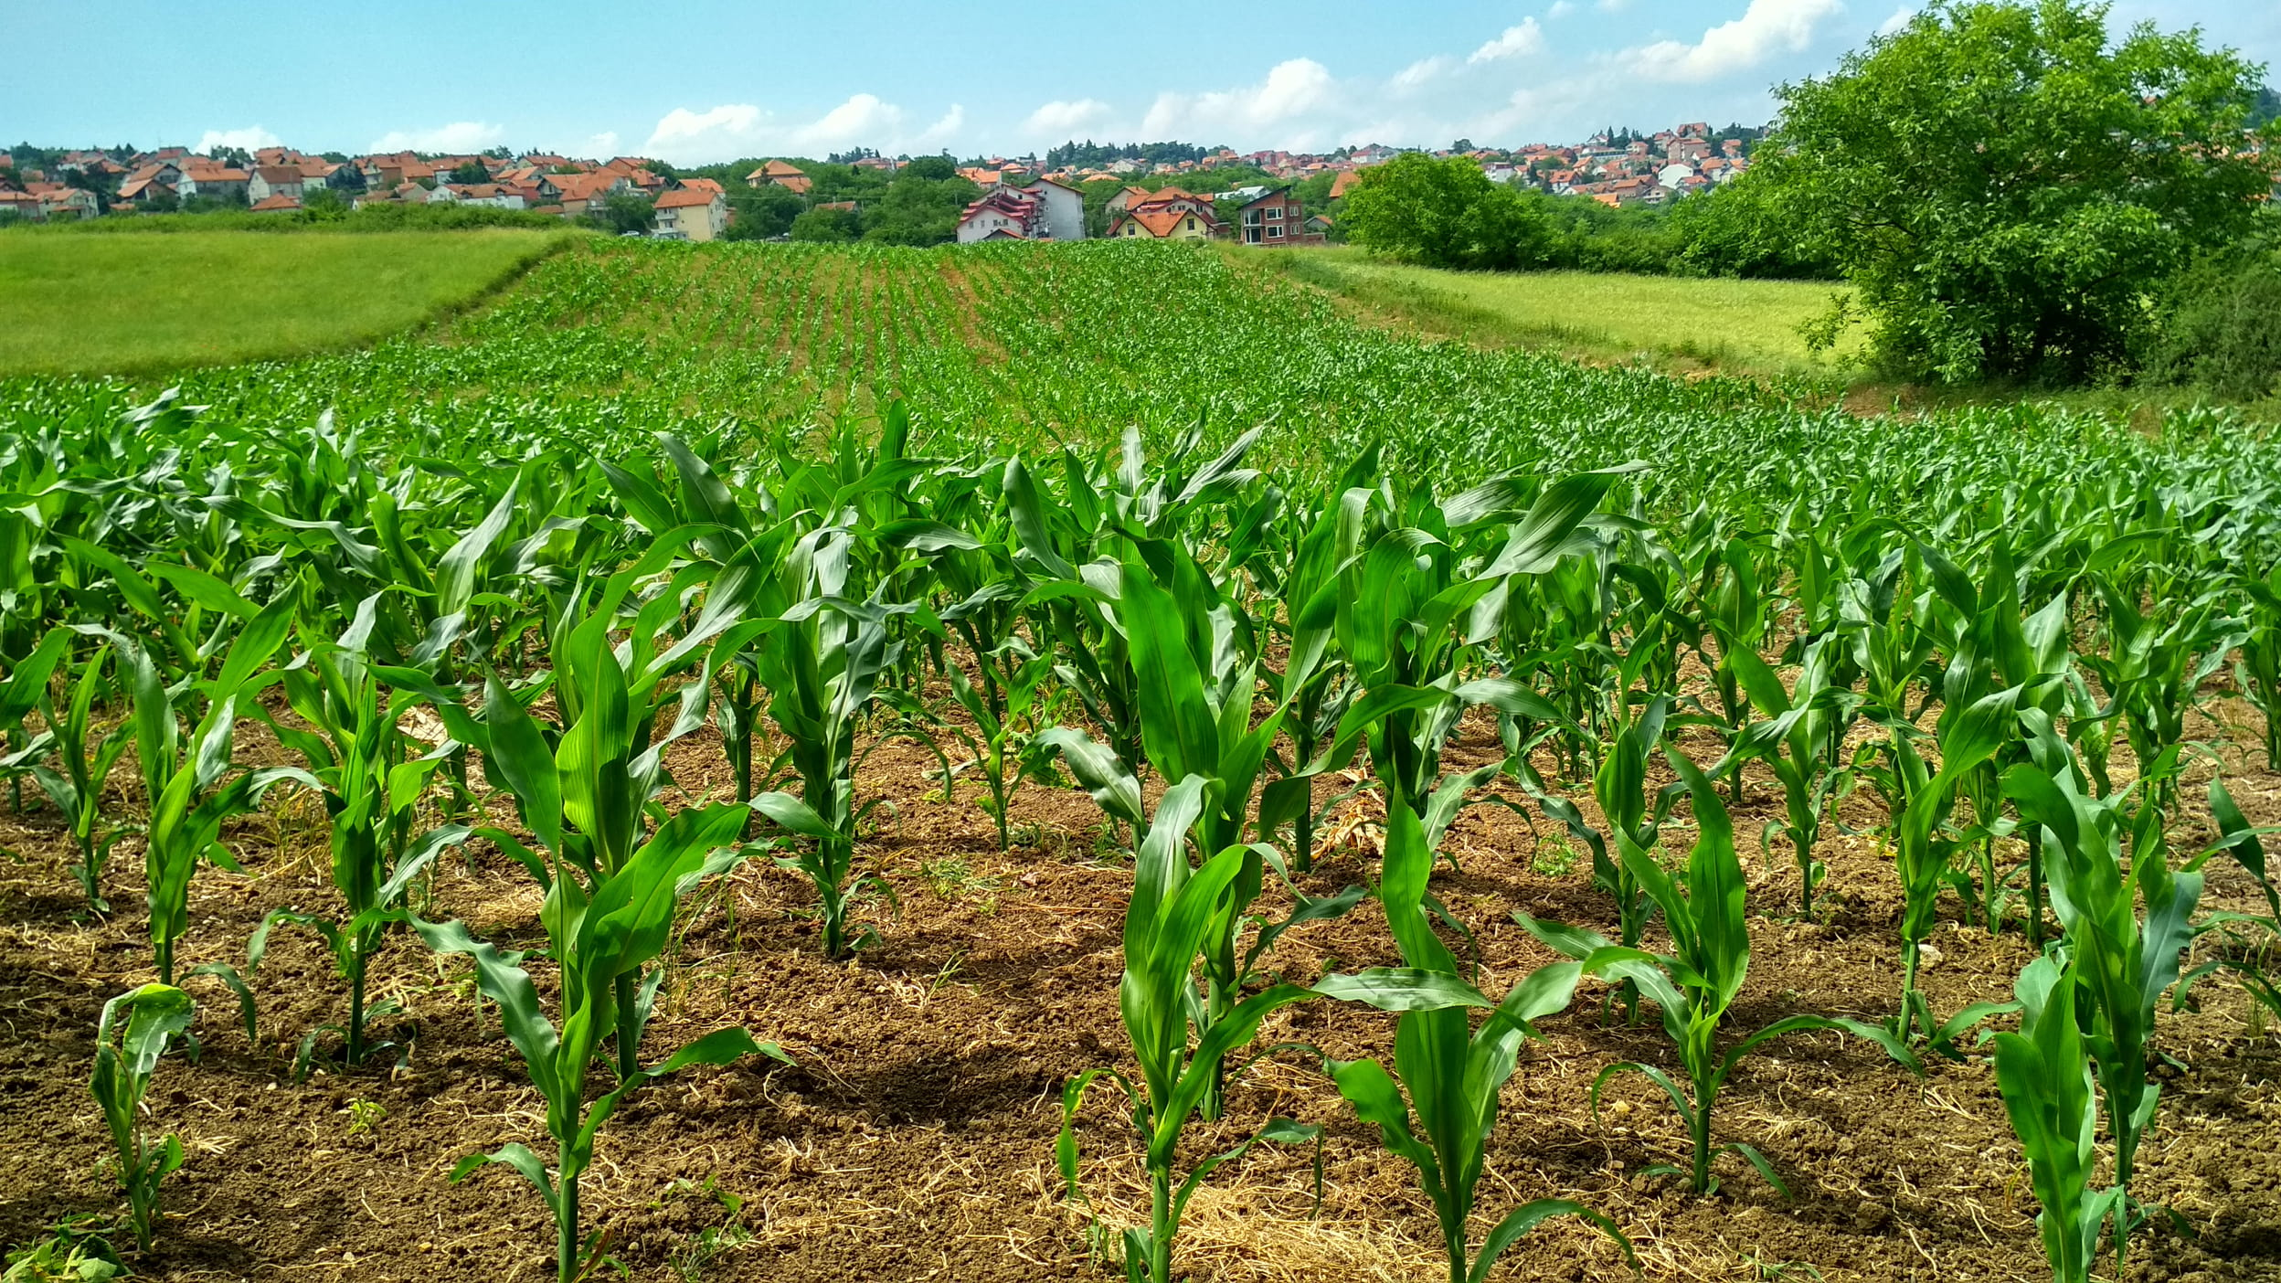
Salford & Co.
Home
About
Contact
System Output – Ranked Crop Recommendations
✅ Benefits:
Gives multiple cultivation options based on likelihood of success
Helps farmers compare and choose based on market, cost, or resource availability
Makes the system flexible and adaptable rather than one-size-fits-all
Based on the input values for soil macronutrients (N, P, K), pH, temperature, humidity, and rainfall, our model analyzes crop suitability and returns a ranked list of the top 5 crops, sorted by how well each crop matches the given conditions.

Slide 5
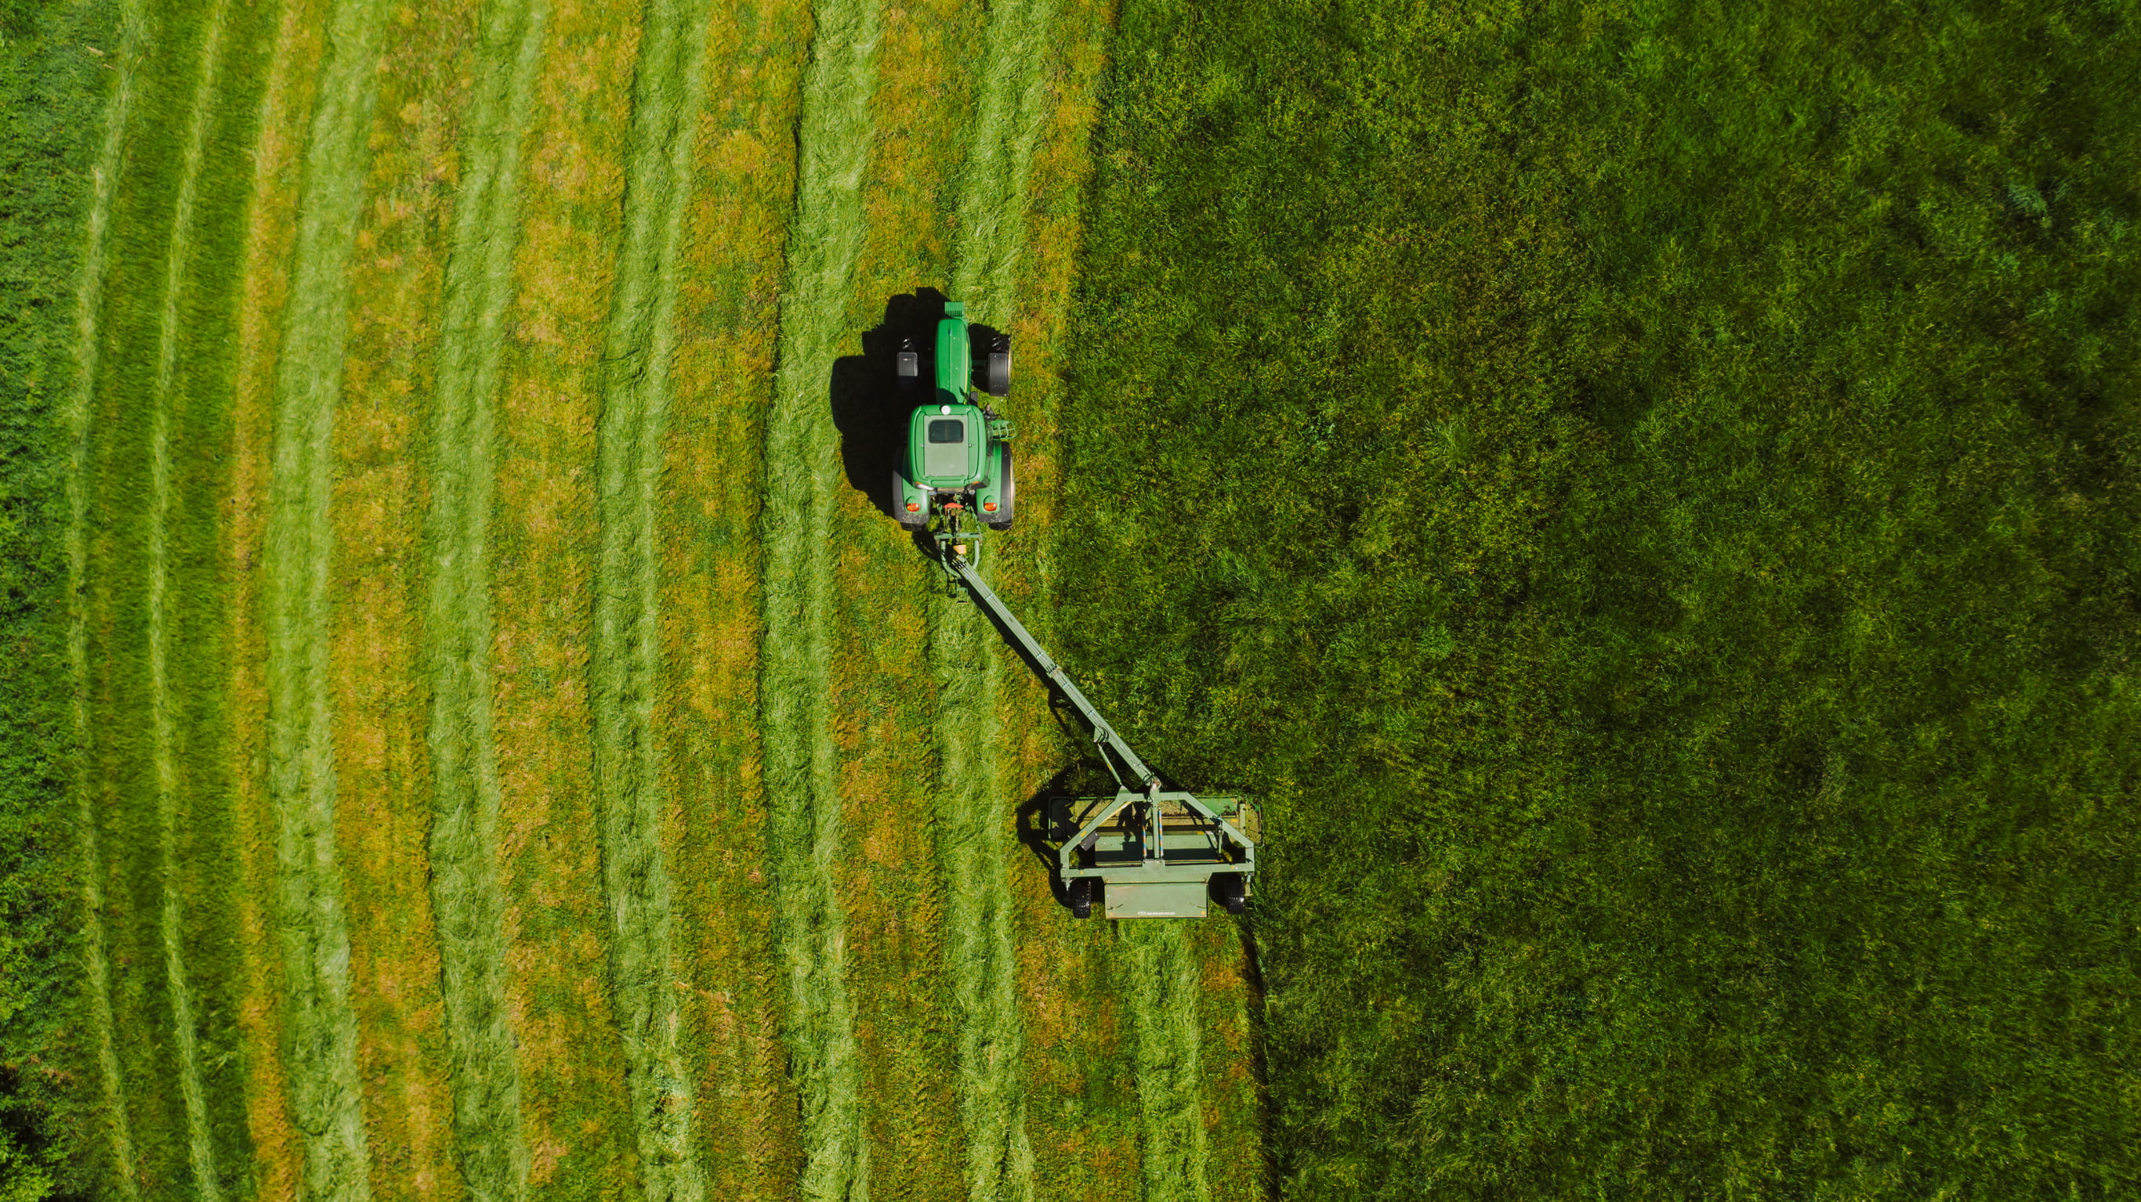
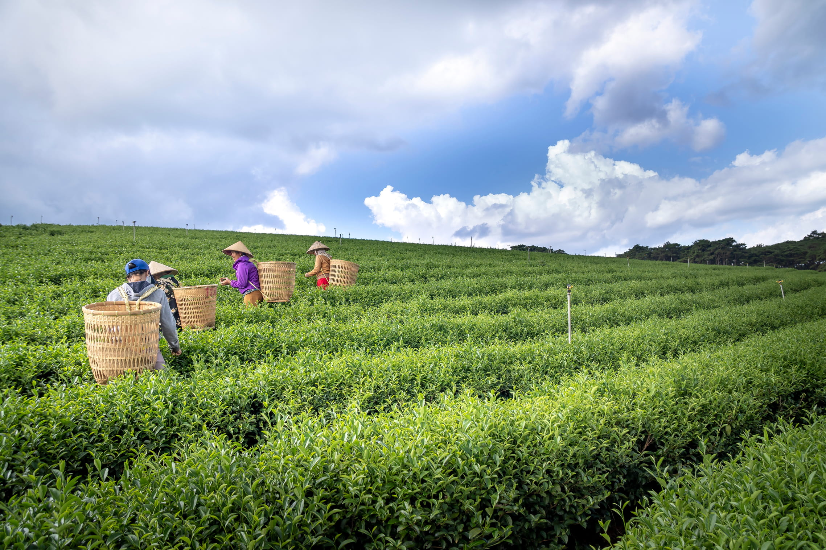
Thank You!
We appreciate the opportunity to present our project:
“Development of a Data-Driven Crop Advisory System Using Soil and Environmental Parameters”
Our goal is to contribute toward smarter, more sustainable, and farmer-friendly agriculture using technology and data.
Team 189 – Learnathon 4.0
👨‍💻 Manan Patel 24CSE015
👨‍💻 Bharat Swaraj Sahu 24CSE057
👩‍💻 Suhani Kumari 24CSEDS014

